Slide 1
Unstoppable Follow twins Kaine and Roxy, both hoping to find successful paths in different sport careers. He is being scouted by a top Premier League club; she is heading for tennis glory at Wimbledon. But there are obstacles; life can get in the way.

Slide 2
“Unstoppable is about sport, family and peer pressure – the forces and obstacles that many young people are facing everyday as they grow up, trying to achieve their dreams.”

Slide 3
Teaching Resources
Here are some ideas to use in the classroom.
They can be used across the curriculum in such areas as English, Drama, P.E. Media or PSHE.
The aim is to encourage young people to think and talk about the issues raised, to react to the characters, to enjoy and reflect upon the story.
Most slides are for direct use with young people; others are more instructions or information for the teacher.
Created by Brenda Heathcote, former Head of English.

Slide 4
Sibling Rivalry - 1
Roxy and Kaine are twins, they used to be inseparable – but now can barely stand to be in the same room together.
Do you have brothers or sisters?
Do you get on or have things changed?
Roxy deliberately cuts Kaine’s football boots before an important match. What’s the worst thing that you have done to any of your siblings – just because you were annoyed with or jealous of them?
In pairs share your ideas – be prepared to report back.

Slide 5
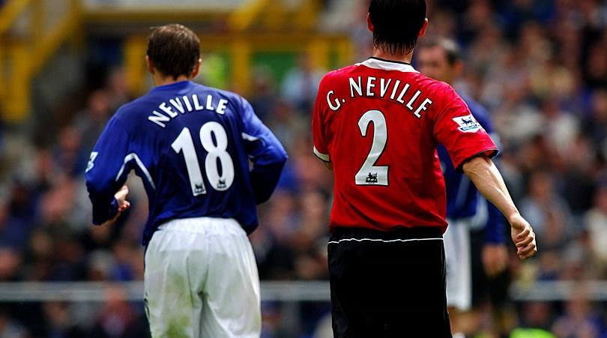
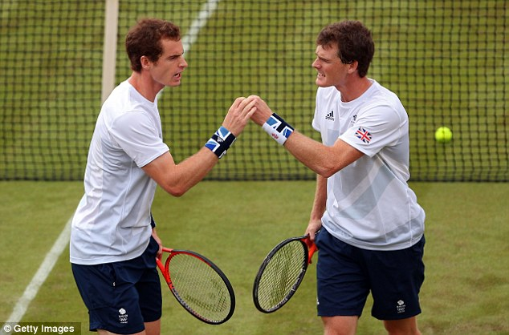
Sibling Rivalry - 2
Some famous sporting siblings: The Neville brothers, the Williams sisters, the Murray brothers.
Do you think they always got on?

Slide 6
Sibling Rivalry - 2
What could be the advantages and disadvantages of your sibling playing the same sport as you?
What could happen if you both have the chance to succeed - but in different sports?

Slide 7
Sibling Rivalry - 3
Roxy keeps a diary, she writes about her frustration with her brother. (page 76)
‘I can’t believe he’s the same boy who used to be my best friend. I can’t believe he’s the same person that I used to share my dreams with. We used to promise each other we would both make it right to the top one day and that we would support each other all the way . . .

Slide 8
Sibling Rivalry - 3
Roxy keeps a diary, she writes about her frustration with her brother. (page 76)
. . . We even used to say that we’d try not to have matches on the same day so that we could give each other all our strength for the other one to use. Can you believe that?! Can you believe that was how close we were? And now . . . now he’s just an idiot who thinks he’s being badly treated and I’m the enemy.
He should try just ONE DAY in MY LIFE.
Trust me, he wouldn’t want to be in these shoes.’

Slide 9
Sibling Rivalry - 3 (teacher info)
‘Walk in my shoes’
Collect some pictures of different shoes on pieces of card, place them on the floor around the room.
Pupils walk around the room; on your signal they stop at a card. Give them a few minutes to think about the shoes at their feet. What would it be like to walk in those shoes?
Take feedback on a few examples then move on. Repeat three or four times. Can we ever really understand how another person may feel?

Slide 10
Sibling Rivalry - 3 (teacher info)
‘Walk in my shoes’ continued
Next just have pictures of tennis shoes and football boots and let every one have a chance to be in Roxy and Kaine’s shoes. How does it feel? What would they do in their situations?
Next pair up as Roxy and Kaine acting in role and talk to each other. Set the scene by the garages where they used to play together when they were younger. (page 72)
Take feedback or see some of the role plays.

Slide 11
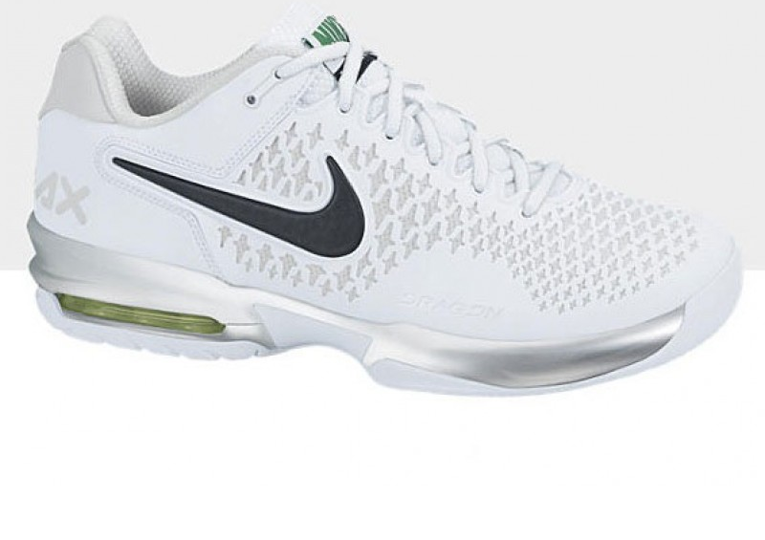
Sibling Rivalry - 3

Slide 12
Parental Pressure - 1
Daryll Campbell coaches his daughter Roxy with a fierce determination.
Samantha Campbell is the breadwinner – working all hours to provide for the family.
Both of their actions put family relationships under strain yet they both believe they are trying to do the best for their children.

Slide 13
Parental Pressure - 1
See useful links below for more information.
https://thecpsu.org.uk/help-advice/topics/parents-in-sport/
https://www.parentsinsport.co.uk/2017/05/26/when-parents-become-too-pushy-in-sport/
What would students do if put under the kind of pressure that Daryll imposes on Roxy. Is he justified?

Slide 14
Parental Pressure - 2
On the other hand, Daryll and Samantha are trying to manage two talented children. Roxy is quite withdrawn and Kaine appears to be quite arrogant.
Daryll is desperately trying to get a job. Samantha is working long shifts and holding the family together. Their son is in trouble at school, he gets involved in local gang conflicts, their daughter has her own huge obstacles to overcome.

Slide 15
Parental Pressure - 2
Then of course there is the trauma Samantha experienced; as a young girl she saw her own brother fatally stabbed outside her school.
So what about the pressures on Daryll and Samantha?

Slide 16
Parental Pressure (teacher info)
Place pupils into groups of 4.
Give each group a sheet of A3 paper which they divide into 4 – one quarter for each member of the family.
Each pupil takes on a character and writes down the pressures that character is experiencing.
Then rotate the sheet round to enable them to write for each character.
Roxy | Kaine
Daryll | Samantha

Slide 17
Parental Pressure (teacher info)
As a group, discuss each character; highlight the main issues, try to think of solutions.
Share ideas with the whole group.
Pupils could then choose one of the four characters to write a letter to, advising that character how to deal with their situation.
Roxy | Kaine
Daryll | Samantha

Slide 18
Structure and Technique
The main part of the story happens over a period of 8 weeks, with the reader being given specific dates to lead them through the events.
How do the names of each part give a clue as to what may happen?
There are graphic additions e.g. text messages, invitations, pictures.

Slide 19
Structure and Technique
How is social media used in the book?
How does it impact on the characters?
Is that helpful to the reader? Did you notice it as you were reading?
How does the way a story is presented to the reader make the book more enjoyable to read?

Slide 20
Structure and Technique
The varied writing styles in ‘Unstoppable’:
The narrative
Roxy’s Diary
Flashbacks with Kaine and Mamma
Newspaper reports
Can students find examples of each style and analyse how effective they are – what are their key features – what do they add to the story?
Teachers may give a few examples to get the conversation started but encourage pupils to find their own.

Slide 21
Structure and Technique – Narrative 1
Kaine had already taken the ball past Rufus Blackstock once, but he went back and did it again, just to show how easy it was.
‘You think you can make me look stupid?’ Rufus said, pushing Kaine hard in the chest. ‘Try it one more time and I’ll break your legs.’ . . . (page 7)

Slide 22
Structure and Technique – Narrative 1
. . . ‘Who do you think you’re pushing?’ Kaine responded, shoving his rival back with such force that he nearly fell over.
‘Leave it, Kaine!’ said Alonso Jackson, trying to pull Kaine away. ‘He started it!’ said Kaine, spitting on the ground and pulling AJ’s arm off him as they walked back into their own half. (page 7)
How does the storytelling help the reader picture the scene?

Slide 23
Structure and Technique – Roxy’s Diary - 1
GOOD DAY: For the first time in weeks, I didn’t have a headache during the day at school. It only kicked in later. Mum says it’s the ‘changes’ in my body (hate the way she says that word ‘changes’).
BAD DAY: Mum and Dad are shouting again now in the kitchen and the headache has come back twice as bad. Is my brain going to explode?
(page 47)
How does her diary show a different side to Roxy?
What clues are there which foretell dramatic events ahead?

Slide 24
Structure and Technique – Roxy’s Diary - 2
Roxy’s diary is her secret place to describe her thoughts and feelings.
‘I just wish I could disappear and no one could ever find me again. And, you know what? If I did, no one would even miss me.’ (page 159)
A diary can be a private place to write your thoughts, hopes, dreams, wishes; but also your fears, anger, frustrations.
Would you read someone’s diary without them knowing?

Slide 25
Structure and Technique – Roxy’s Diary - 2
Kaine reads Roxy’s diary and later actually writes in it!
‘I’m so sorry that you were so unhappy – I swear I didn’t know I thought you were happy and I was the only one that was unhappy.’ (page 229 – 238)
Too often we read about how, after someone has died, family and friends find a diary or journal and are shocked and surprised at what they find written there.
How can a diary both help and hinder you?

Slide 26
Structure and Technique – Flashback - 1
‘Let me tell you about what I see when I go to sleep,’ Mamma said, putting the phone down and clasping Kaine’s hand tightly. She had soothingly cool hands, and whenever Kaine could feel his body or his anger over-heating, just holding his grandmother’s hand seemed to calm him down. . . (page 35)

Slide 27
Structure and Technique – Flashback - 1
. . . ‘Every night, when I close my eyes, the same picture comes into my head. It’s you, sprinting on a football pitch, riding the wind, just like me. I send that image out to the stars, and I know it’s going to come back to us.’ (page 35)
How do the flashbacks between Kaine and Mamma reveal more of the overall story to us?
What do we find out about the family? Find 5 facts.

Slide 28
Structure and Technique Newspaper reports
BOY, 14, STABBED TO DEATH
Model student, Anthony Augustine, killed in what is believed to be a case of mistaken identity as he waited to pick his sister up after school. Tragedy linked to gang battles on the notorious Compton Estate…
(page 84)
How does a newspaper extract move the story on or give the reader essential information?

Slide 29
Characters
How do the other characters in the book influence or have an effect on Kaine and Roxy?
Using a hexagon template, students to work in groups seeing how the different characters link up.
Where do their different journeys link up or cross over?

Slide 30
Characters (teacher info)
Print off hexagons in different colours. One for characters, one for events and incidents, one for language used e.g. a quote or the actual technique.
Give each group a selection of hexagons. Ask them to write on the hexagons in the different categories. Then they work together, reading the hexagons and trying to link them creating chains, adding on more hexagons as their discussions progress. What do the links created show us about journeys and relationships within the story?
Kaine
Football scout watches a match
Mr Kerrigan
‘So are you going to sign me then?’

Slide 31
Characters – Lollipop stick Lottery (teacher info)
Get some plain wooden lollipop sticks. Divide into two packs – one for characters, one for events.
Write on one set the names of the characters in the story. On the other set write events from the story.
Have the sets in two different containers.
Pupils pull out one from each container and have to explain their reactions, or actions, or opinions to the chosen event as if they were the chosen character.

Slide 32
Characters – Lollipop stick Lottery (teacher info)
You can adapt this by using different colours of lollipop sticks for characters, themes, events.
Pupils could work in pairs or small groups to build confidence.
Take the discussion further with:
What could they have done?
What should they have done?
What would you have done?

Slide 33
Kaine – attitude and behaviour
It’s easy to get into an ‘It’s not fair . . .’ state of mind when something does not go the way you wanted.
Kaine is bitterly disappointed when the football scout turns him down and gives him some home truths. (page 113-115)
There is a difference between confidence and arrogance.

Slide 34
Kaine – attitude and behaviour
How does Kaine’s attitude and behaviour influence the events around him?
How could he have improved his attitude and behaviour?
Plot a reaction graph showing your feelings towards Kaine as you read more about him.
Use a simple line graph format to show your changing opinion.

Slide 35
Slippery Slope
Kaine does not want to carry a knife, he does not want to get involved with Sheldon and the Compton Estate gang – but somehow that is exactly what happens.
How?
Create a timeline plotting how Kaine becomes entrapped in that descending spiral.
Poor behaviour in class
Setting off the fire alarm
Meeting the football scout

Slide 36
Slippery Slope
This will give you a visual representation of Kaine’s life. Can you see the mistakes, the events, the people that had that effect on him?
You could create a shape to illustrate his story.
U shape? Circle? Other?
Poor behaviour in class
Setting off the fire alarm
Meeting the football scout

Slide 37
Knife Crime (teacher info)
There is so much information available on this subject to the public. News reports, viewpoints, initiatives etc that it is probably best to search the most recent news to prompt discussion in the classroom. Unfortunately you may well have a local news story connected with the subject.
www.benkinsella.org.uk is also excellent and they offer workshops in certain areas.

Slide 38
Knife Crime (teacher info)
The important point is not what you actually discuss; but how you have that discussion with young people.
You will know those young people the best and therefore the best starting point relevant to them.

Slide 39
How to save a life
The death of his beloved Mamma haunts Kaine as he could not help her. He panics when he finds her collapsed and genuinely does not know what to do. (Page 110)
Would you? - Do you know your ABC?
Airway
Breathing
Circulation
Could you do CPR – Cardiopulmonary Resuscitation?
How many people have first aid knowledge? Ask among your friends if they know what to do in an emergency situation like Kaine.
Visit these sites to find out more:
www.sja.org.uk and www.redcross.org.uk/firstaid

Slide 40
Disability - suggested talking point 1
Roxy has a brain tumour and she loses the ability to walk - she becomes disabled. Under the Equality Act, a disability is defined as any long term impairment which has a substantial, adverse effect on your ability to carry out day-to-day activities. Examples include conditions which affect your learning, mobility, physical coordination, mental health, speech, hearing or eyesight as well as conditions such as diabetes and epilepsy which may normally be controlled via medication.

Slide 41
Disability - suggested talking point 1
Do you have any experience of disability?
Maybe you have a personal insight from a member of your family or friendship group or neighbours?

Slide 42
Disability - suggested talking point 2
Roxy feels angry, frustrated; feels that her life has come to an end.
Suddenly becoming a disabled person is very hard. It takes time to adjust to your new life. Disabled people live with impairments and have lives as fun and fulfilling as non-disabled people. However, there are many barriers in the world that make life difficult. Some barriers are physical; like stairs for wheelchair users, or no subtitles for a deaf person, or noisy unpredictable environments for people with a certain type of autism.

Slide 43
Disability - suggested talking point 2
But there are also social barriers; being ignored or excluded when you go out, being stared at, laughed at, being called names, or people thinking you are not capable at school or when you go for interviews. It is these barriers that really make people ‘disabled’.
Can you think of some examples of physical barriers – such as for a wheelchair user or someone who is blind or visually impaired?
Can you think of some examples of social barriers – where the obstacles are because of attitudes?

Slide 44
Disability - suggested talking point 3
Roxy comes to realise that she is the same person as she was before; with the same passion for sport, and the same focus, fight, grit and determination. She turns her attention to wheelchair tennis and becomes the champion that she always knew she would be. Roxy becomes a Paralympian representing her country.
Have you ever watched disability sport?
What disability sports do you know about?
Do you know the names of any Paralympians?

Slide 45
Disability - suggested talking point 4
There are 13.9 million disabled people in the UK. Of all the children in the UK 8% are disabled (figures from Scope). However you do not see many disabled people on screen, online, in film, TV, video and audio, or in books and magazines.
Have you noticed disabled people in the media? Can you give some examples?
If disabled people and their lives were featured more often, would this help to remove some of those attitude barriers?

Slide 46
Useful links
To find out more about disability and to help develop further thinking and discussion try these websites:
www.scope.org.uk
www.Paralympics.org.uk
www.autism.org.uk/
www.bdadyslexia.org.uk

Slide 47
Useful links
To develop further thinking and discussion about subjects in Unstoppable:
www.redthread.org.uk
www.sja.org.uk
www.sportengland.org/our-work/disability
https://thecpsu.org.uk/help-advice/topics/parents-in-sport/
https://www.parentsinsport.co.uk/2017/05/26/when-parents-become-too-pushy-in-sport/
Take a look at . . .
Chicken Shop Grooming - A powerful message for everybody. Choose how you may wish to use this with young people and their families.
https://www.youtube.com/watch?v=OH895nZ1arE

Slide 48
‘Unstoppable’ the Book Trailer Challenge!
Now you have read the book here’s your chance to tell others all about it.
Create, perform and film your own 90 second trailer where you tell other readers all about ‘Unstoppable’ and why they should read it.
Introduce them to Kaine and Roxy; their turbulent relationship and their dramatic story.
What important messages would you want to include?
How will you get your views across to the audience?
What will make your Book Trailer stand out from the crowd?
Dan will post the best ones on his website – so get together and get filming! Send your best ones to Unstoppable@DanFreedman.co.uk

Slide 49
and finally . . .
Kaine and Roxy are unstoppable.
They pursue and achieve their goals through challenges and disappointments – but that’s life.
What about you? - Are you unstoppable?
What are your dreams and aspirations?
Are you going to allow people and events to knock you off track or are you going to persevere and achieve your dreams?
Good luck because you can do it!
Dan Freedman
DanFreedman.co.uk Twitter: @DanFreedman99 Insta: @DanFreedman_99

